Slide 1

Voxellancer
I believe I can fly
by Christian Dullweber and Moritz Eyssen, Sebastian Gerstenberg and Patrick Siegler
under guidance of Daniel Limberger

Slide 2
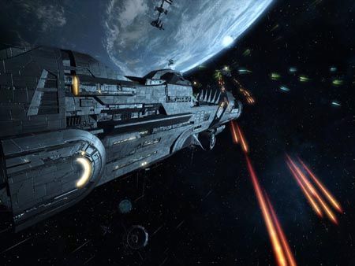
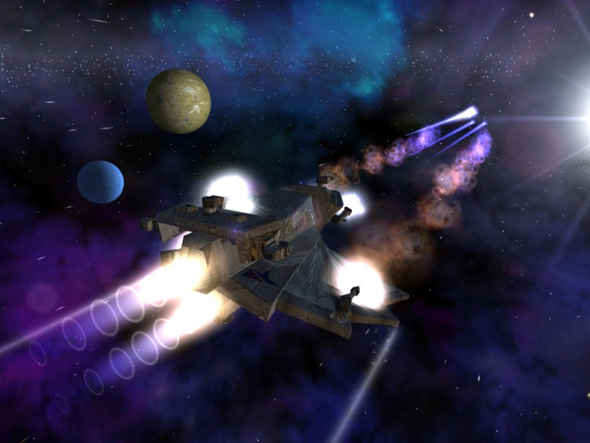
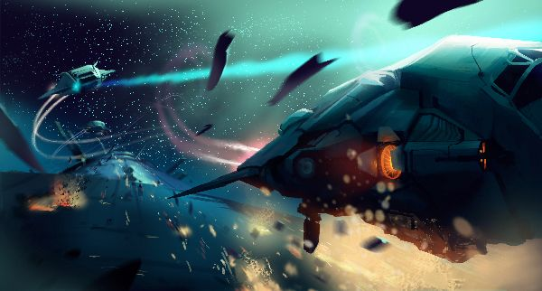
Motivation: Space
Space games are awesome
Dogfight combat
Science fiction setting
Open world
Not limited by „realism“
As previously seen in games like:
Freelancer
X-Series
Eve Online

Slide 3
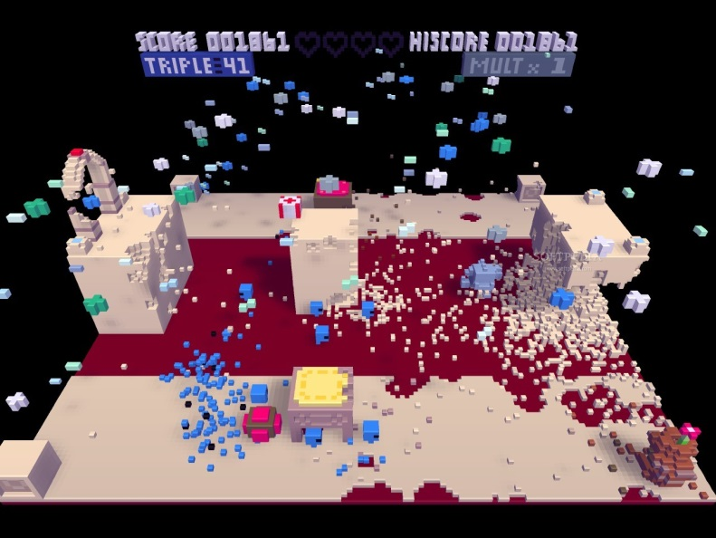
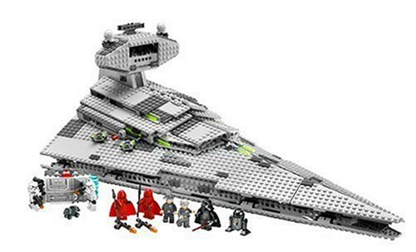
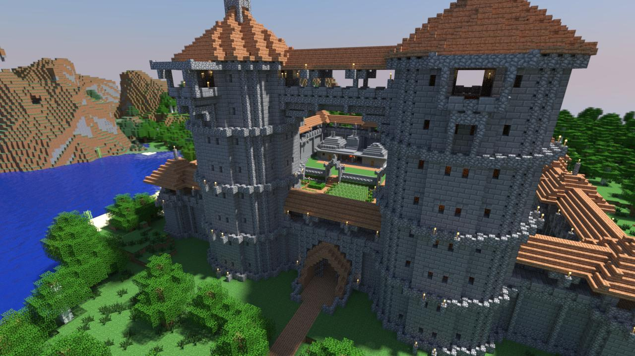
Motivation: Voxels
Simple model design
Lego-like modeling
Fully destructable world
TODO!
As previously seen in games like:
Voxatron
Minecraft

Slide 4
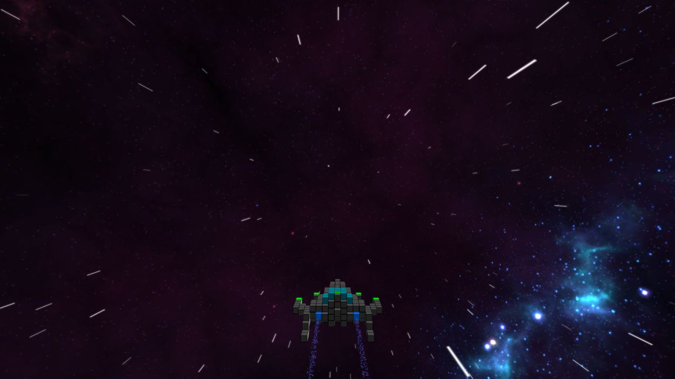
Trailer

Slide 5
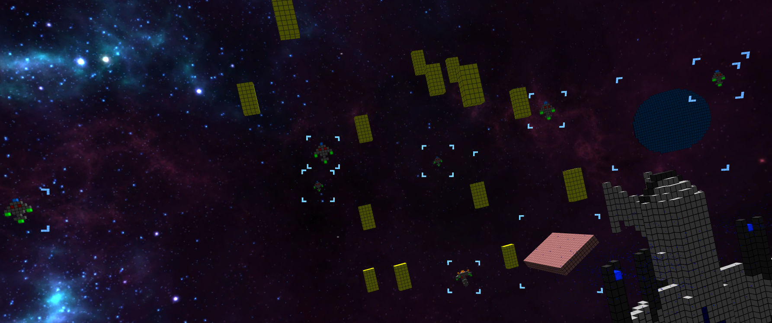
Features
Physics – Missions – Collisiondetection – Reloadable Configs – AI – Squads – Modding – Particles – Scripting – Antialiasing – HUD – OculusRift Configurable Controls – Homing Missiles – Gamepad/Joystick support – Factions – Equipable Weapons and Engines – Postprocessing – Starfield 3D Sound – Formation Flight

Slide 6
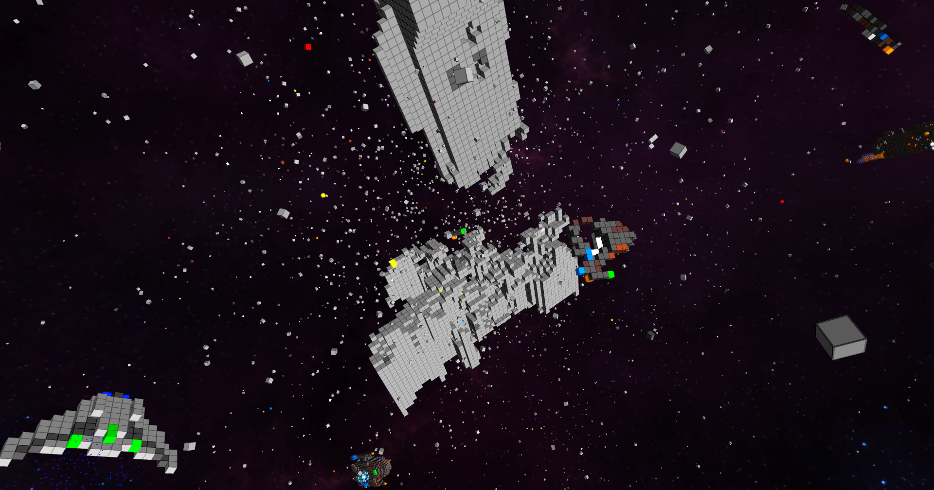
Engine
Physics
CollisionDetection
Damage with Splitting

Slide 7
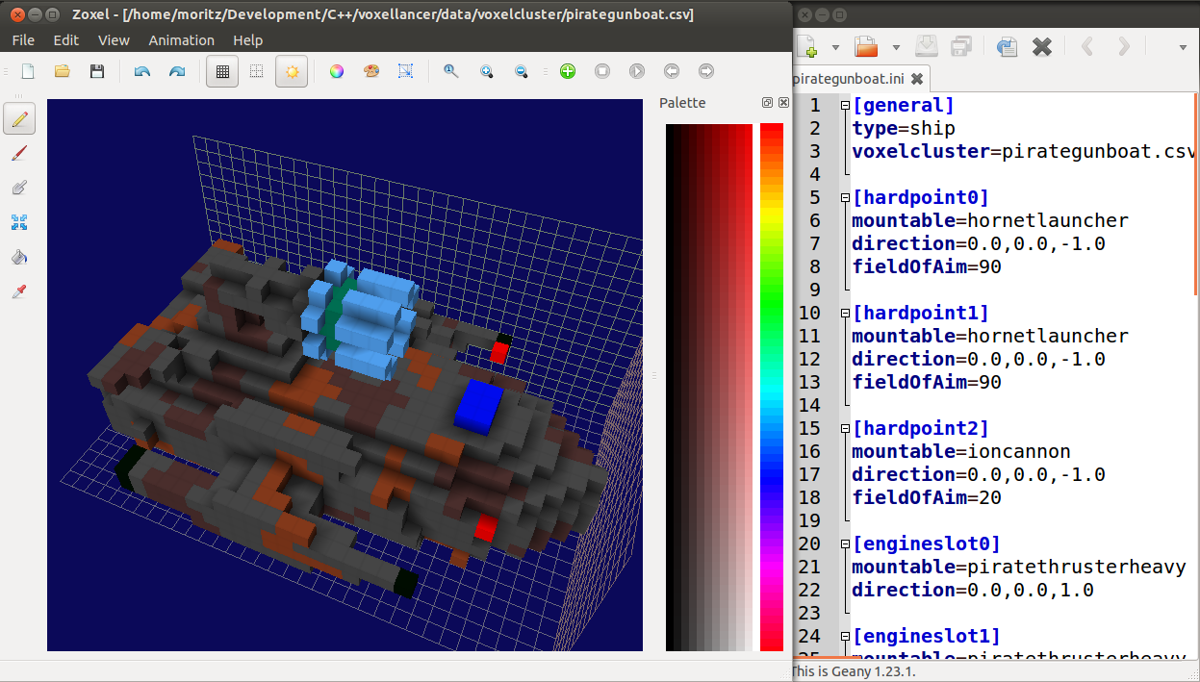
Modeling

Slide 8
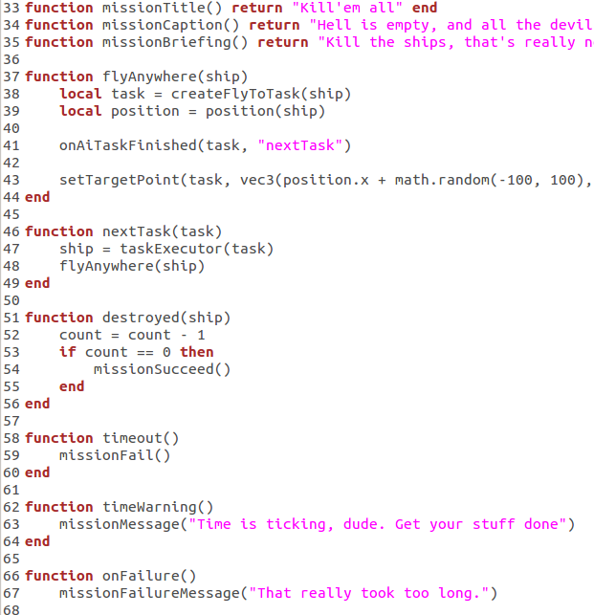
Scripting

Slide 9
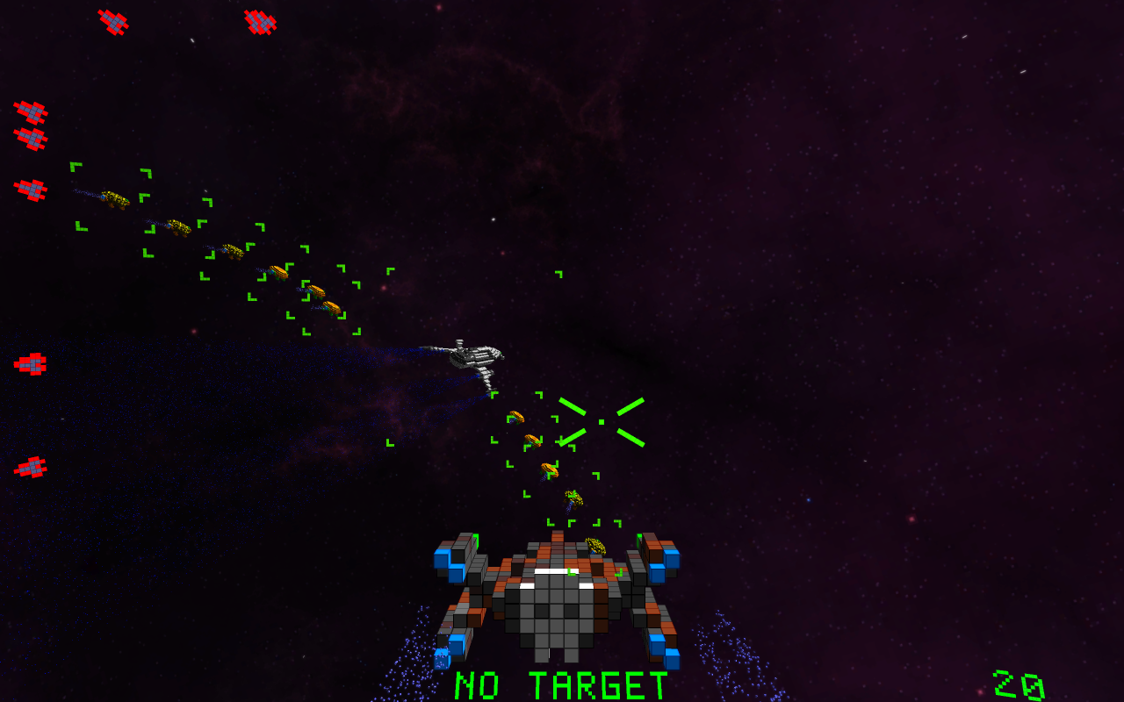
AI and Squads

Slide 10
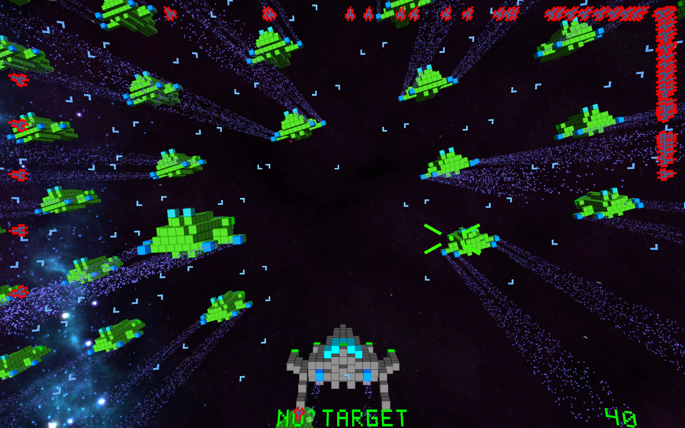
ParticleEngine

Slide 11
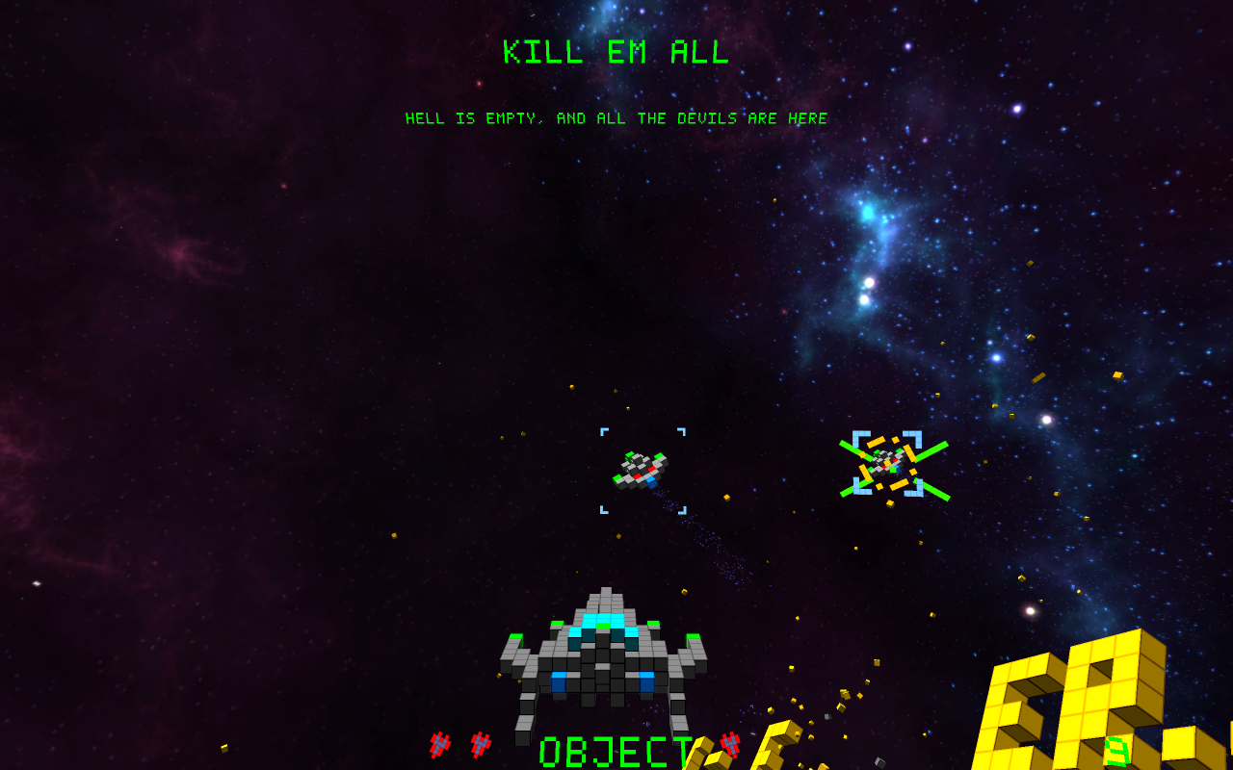
HUD

Slide 12
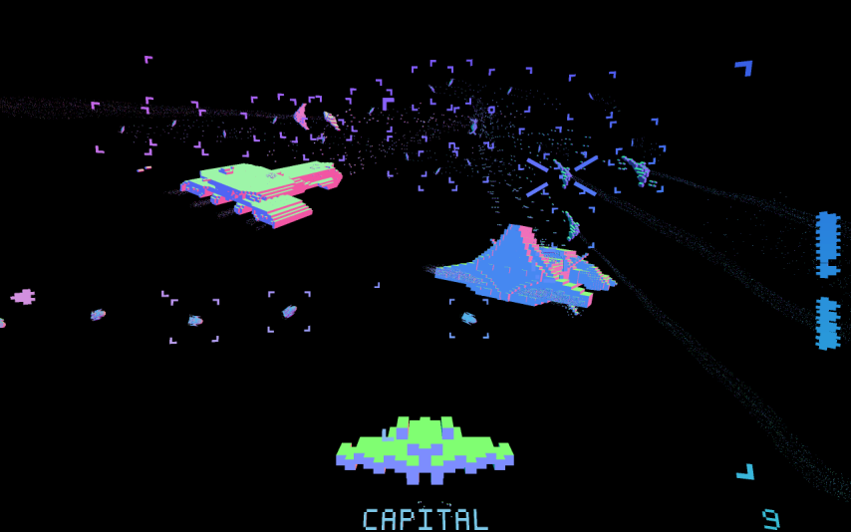
Post Processing & Effects

Slide 13
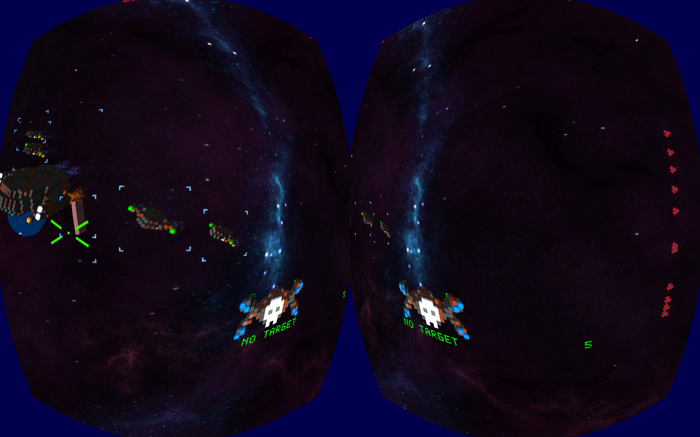
Oculus Rift

Slide 14
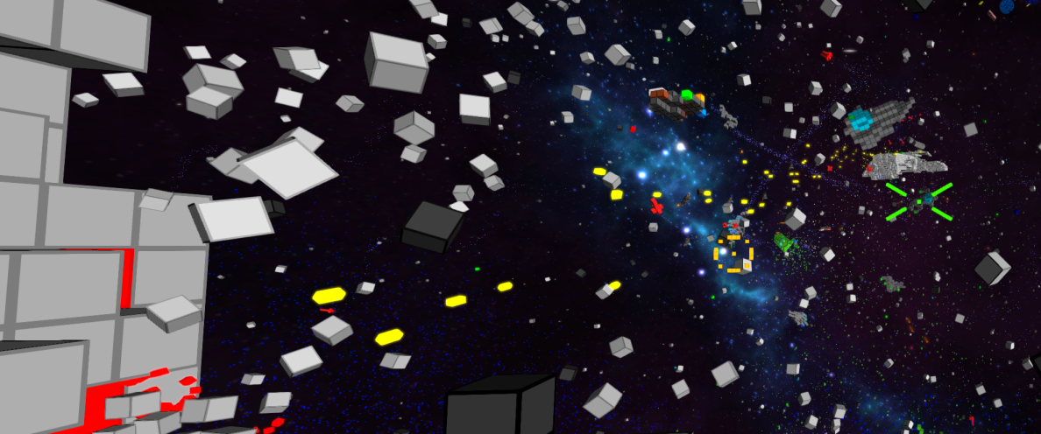
Behind the Scenes

Slide 15
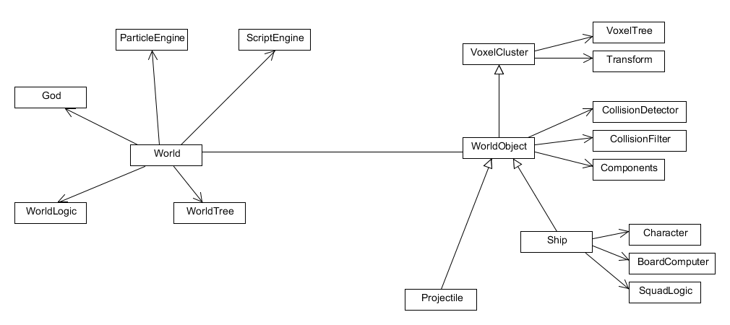
Quick Overview
Add sound, voxelrenderer, voxelrenderdata, input, world bidirectional. Worldtree als scenengraph. Beispiel: insertion in world

Slide 16
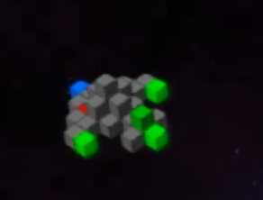
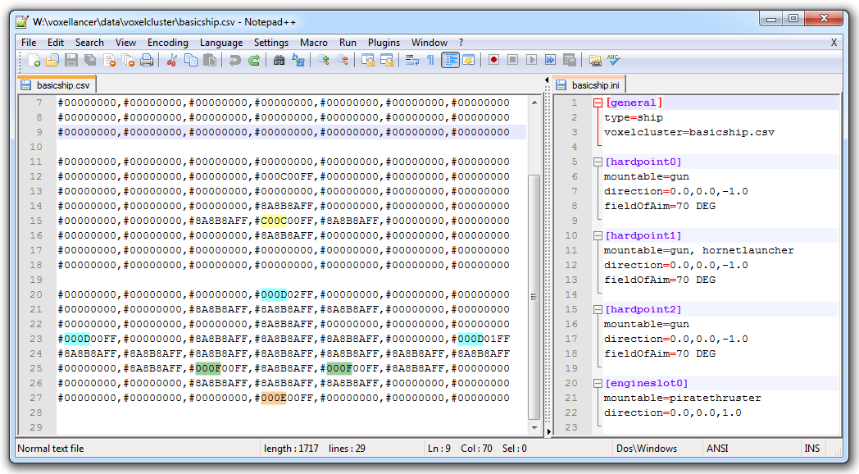
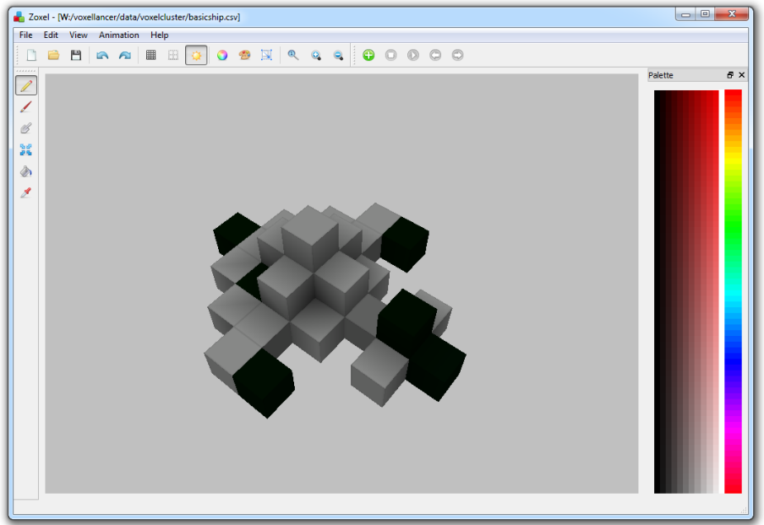
Models
Models are designed in Zoxel
HardPoint/EngineSlots encoded via special colors
Installed weapon/engine defines color in game
Modeled in Zoxel, configured via .ini

Slide 17
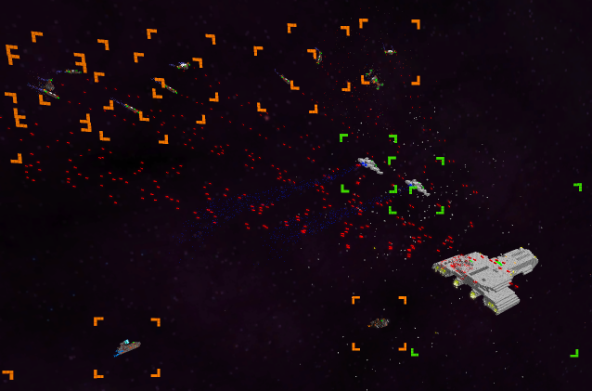
AI - Tasks
Tasks can be assigned to NPCs
Nested tasks for complex behaviour
NPCs can form squads to perform mutual tasks

Slide 18
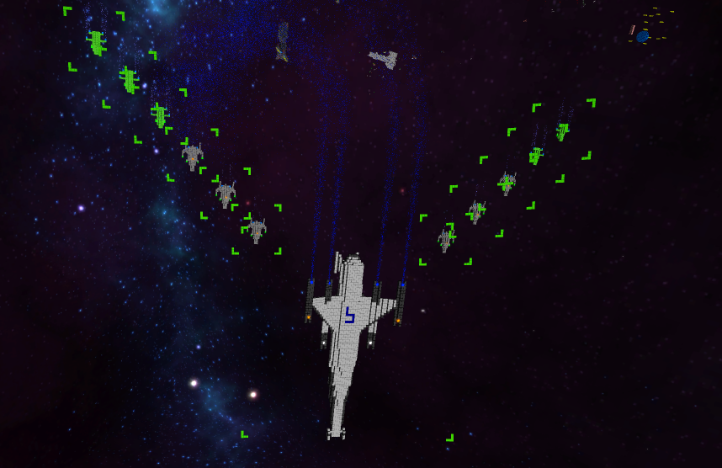
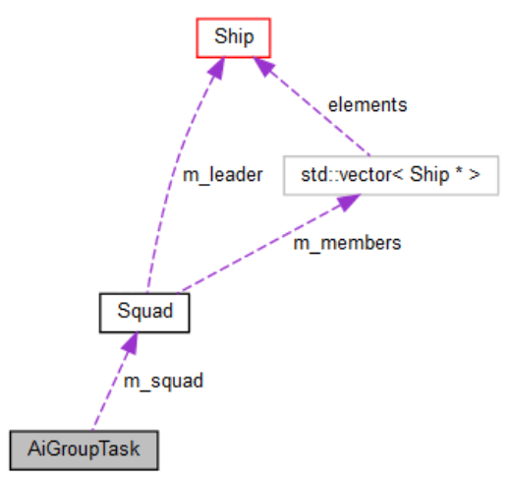
Group Tasks

Slide 19
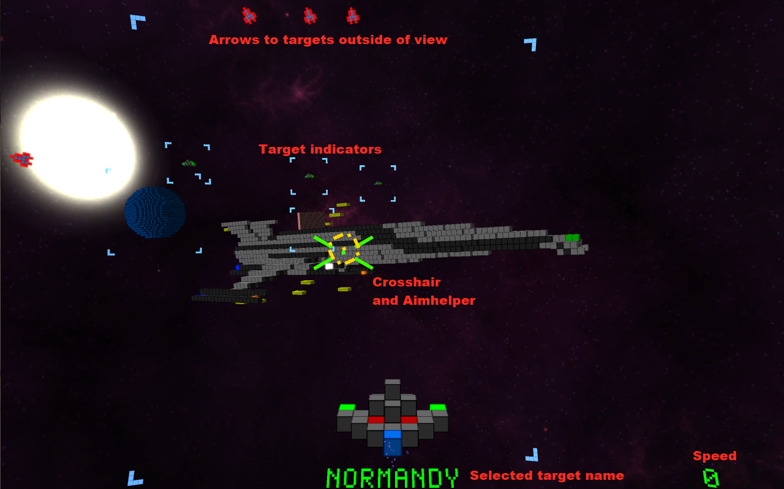
HUD
Notes:
HUD elements are placed on a sphere around the camera
Sphere (supposivly) allows easy integration with Oculus Rift
Creates a „HUD on Helmet“ illusion
Spherical HUD creates problems on the Rift for hudgets outside of the focus.
Due to the different viewing angles and distance to hudgets along the edges, the hudgets appear twice.

Slide 20
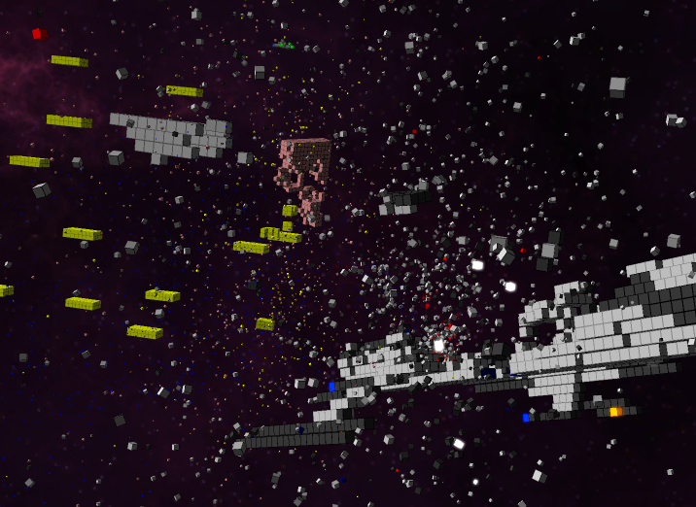
ParticleEngine
How to simulate a huge amount of particles?
voxelparticledata.h
struct VoxelParticleData { glm::vec3 creationPosition; glm::vec3 creationEulers; glm::vec3 directionalSpeed; glm::vec3 angularSpeed; float creationTime; float deathTime; float scale; uint32_t color; float emissiveness; };
voxelparticle.vert:
float timeDelta = currentTime - creationTime;
vec3 particlePosition = directionalSpeed * timeDelta + creationPosition;
vec3 eulers = angularSpeed * timeDelta + creationEulers;
vec4 orientation = quat(eulers);
gl_Position = viewProjection * vec4(qtransform(orientation, v_vertex) * scale + position, 1.0);
→ Very few buffer updates neccessary!
Notes:
250.000 Partikel im Trailer

Slide 21
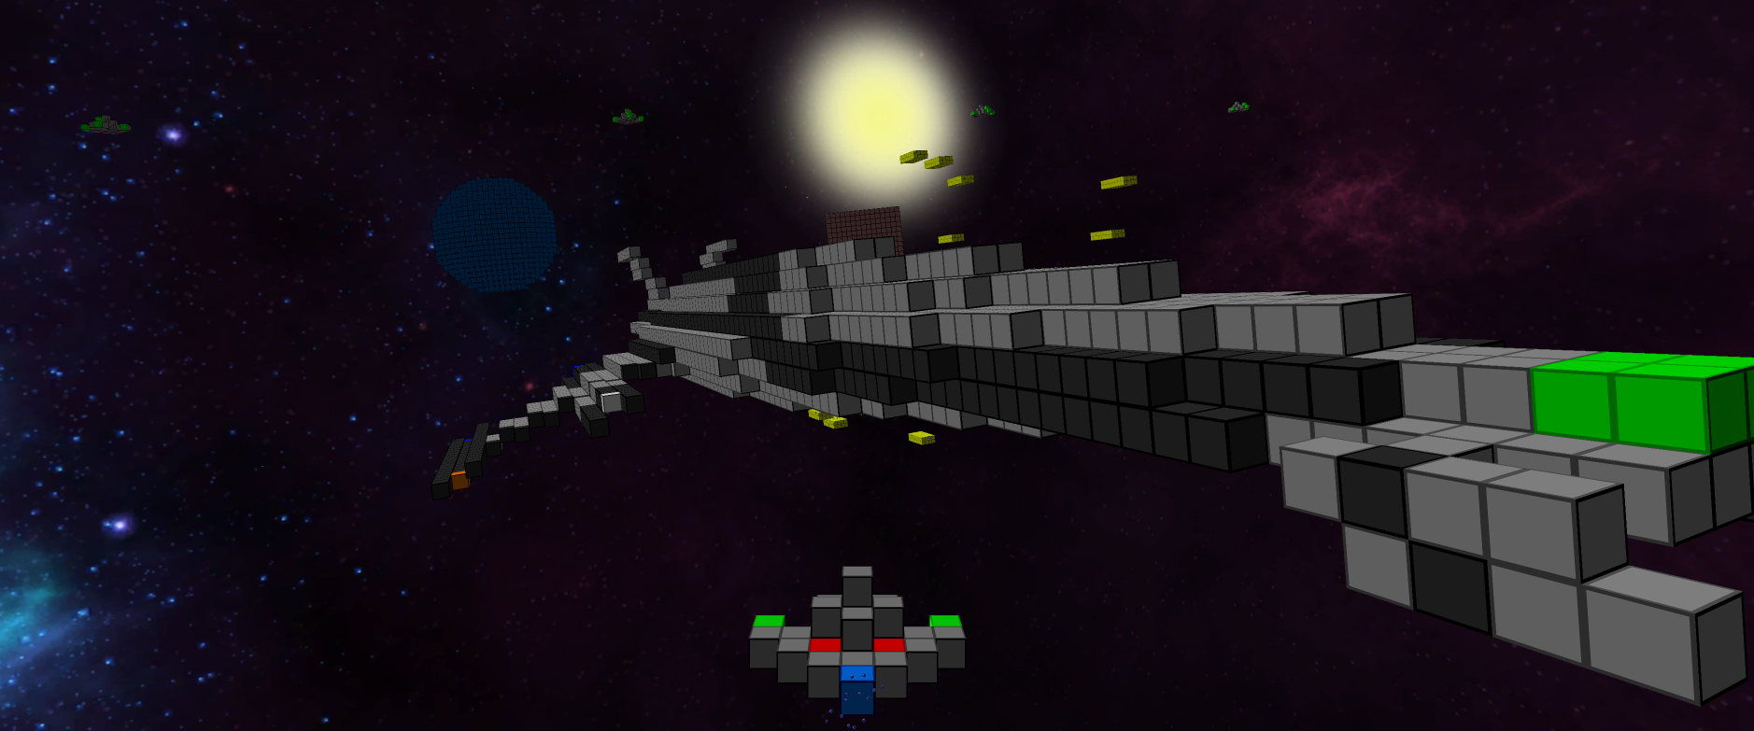
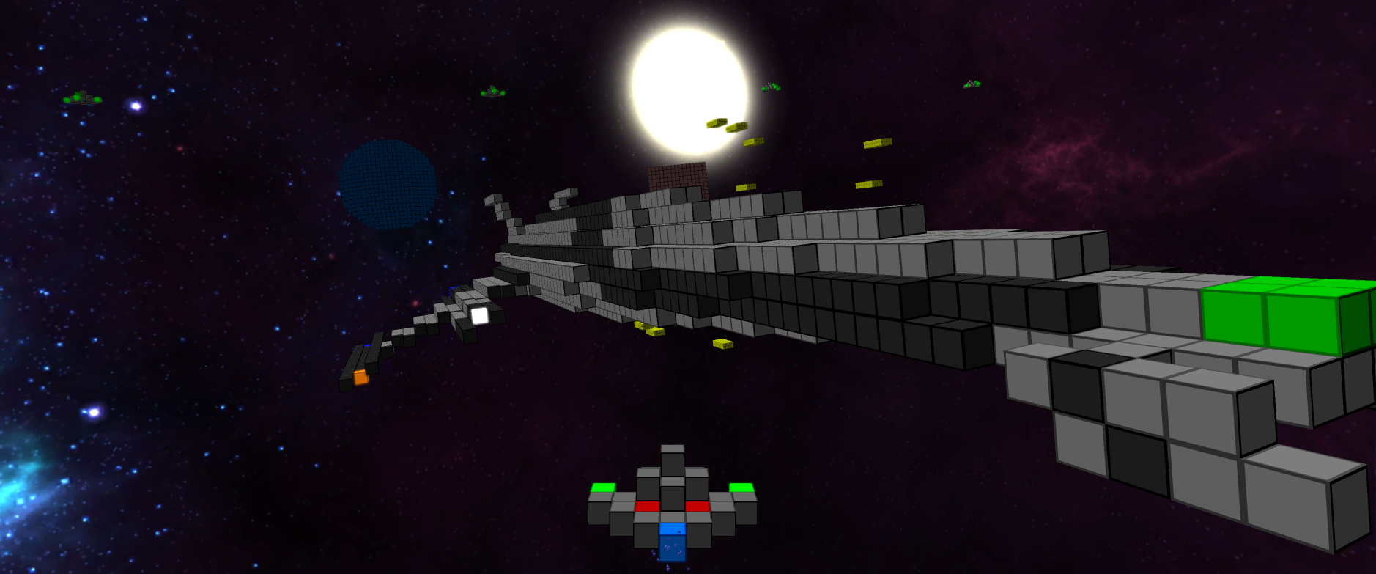
Postprocessing

Slide 22
RenderPipeline
auto pass = std::make_shared<PostProcessingPass>("blurv", m_quad);
pass->setInputMapping({ { "source", BufferNames::Emissisiveness } });
pass->setOutput({ BufferNames::BlurTmp });
pass->setFragmentShader("data/shader/postprocessing/blur.frag");
pass->setUniform("direction", glm::vec2(0, 1));
add(pass)

Slide 23
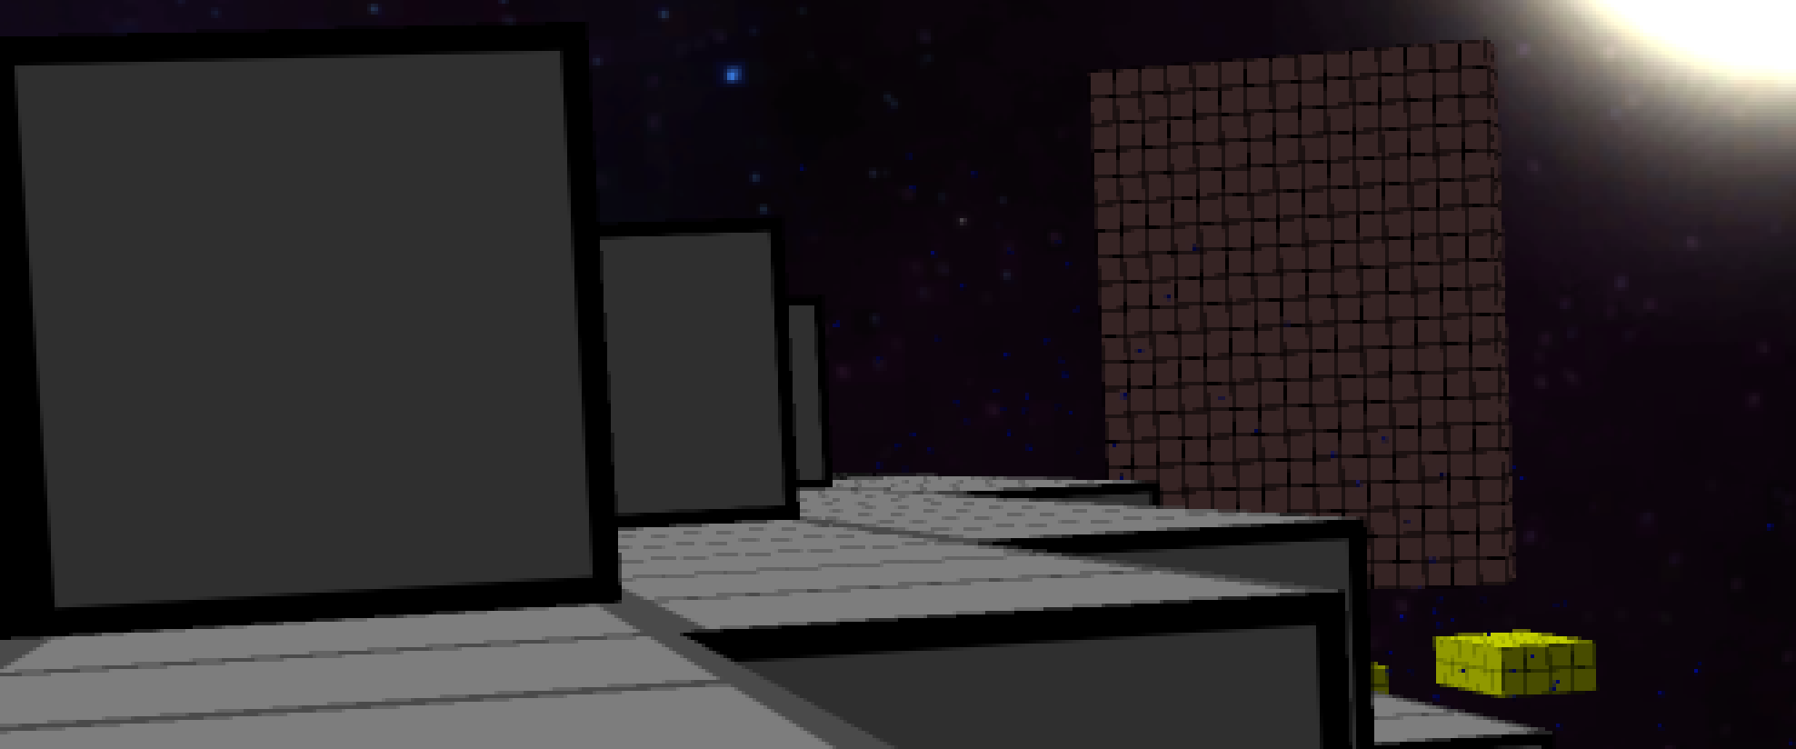
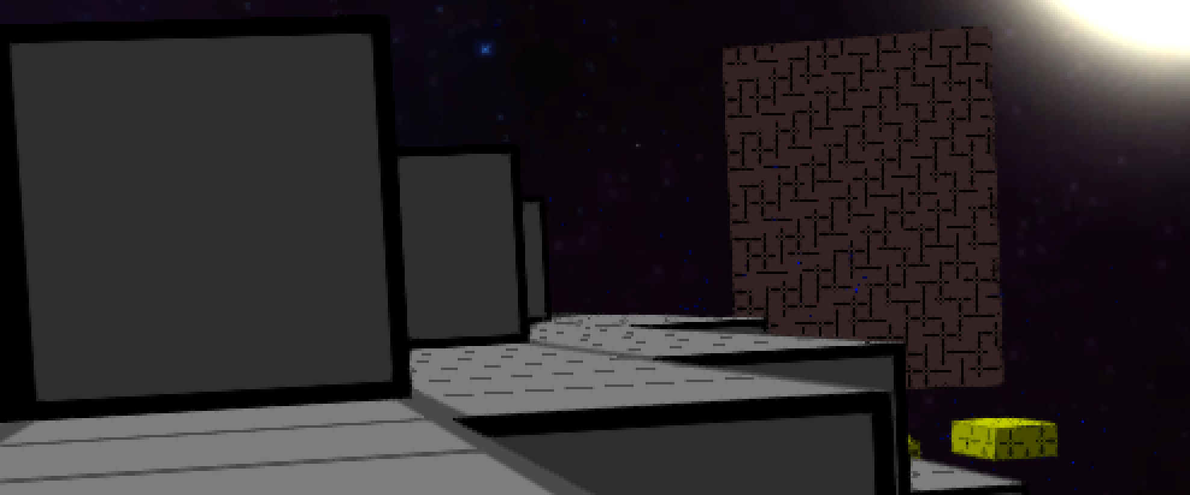

Antialiasing
fxaa
no aa
2x super sampling

Slide 24
Projectmanagement
TODO

Slide 25
Libraries & Tools
GLFW
GLOW
GLEW
GLM
SFML::Audio
OculusSDK
Lua + Elemate Lua bindings
Bandit (unit tests)
GitHub
github.com/voxelinc/voxellancer
Jenkins
Zoxel

Slide 26
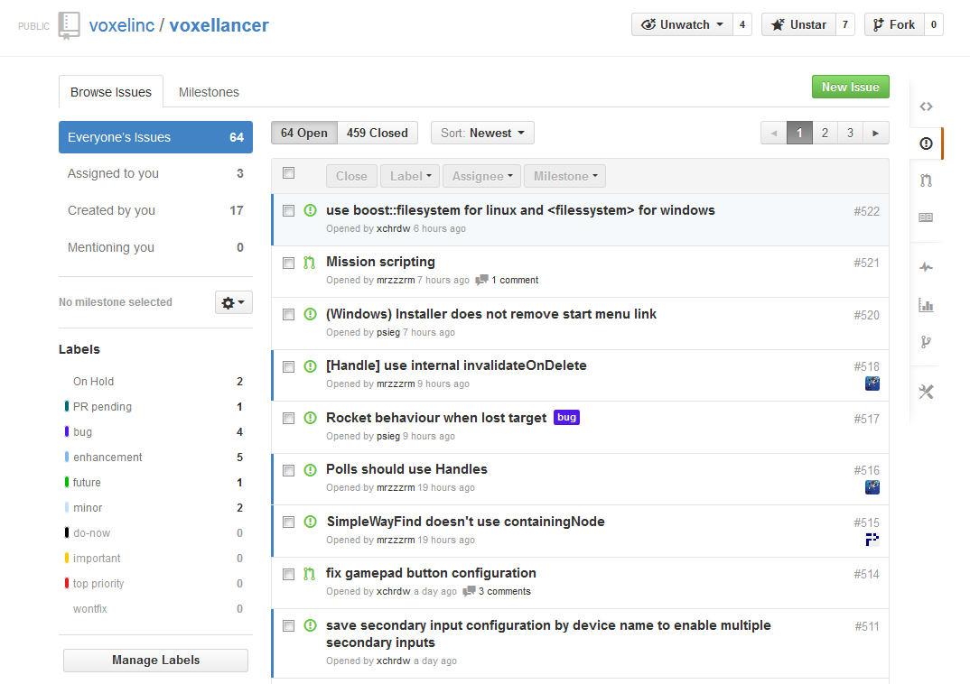
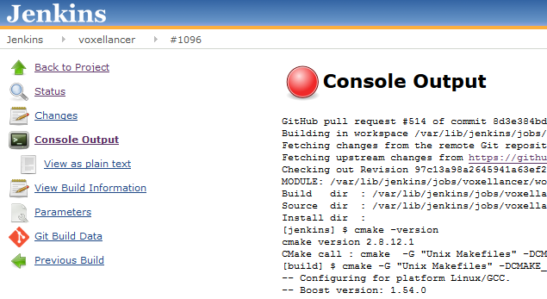


GitHub Workflow
GitHub Issues
Pull Requests and 4-Eyes-Review
GitHub-Jenkins Integration
Weekly team meetings

Slide 27
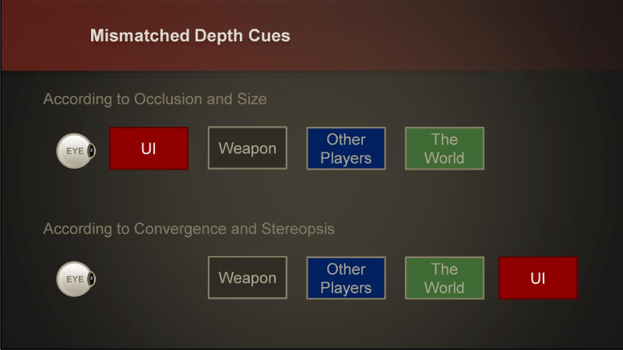
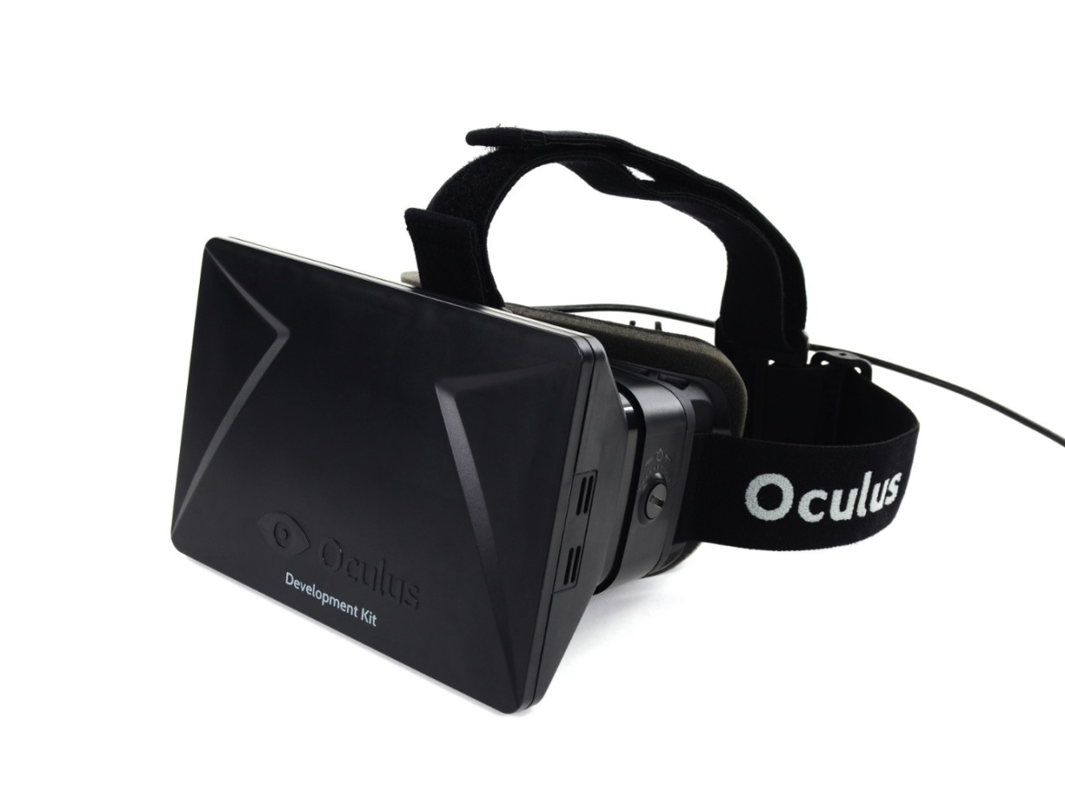
Issues: HUD and Oculus Rift
→ Spherical HUD around the player head

Slide 28
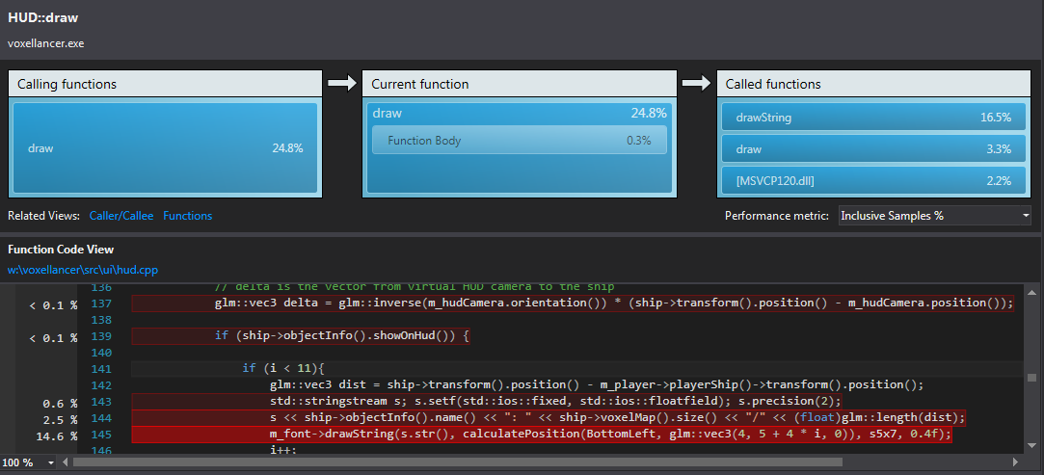
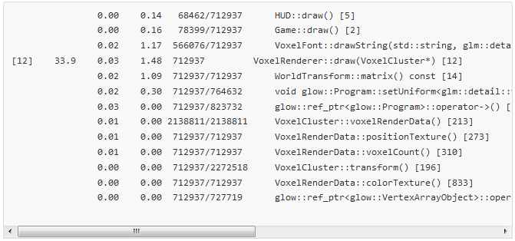
Issues: Performance
Debug mode, especially on windows, things can get very slow
Different performance behaviour on different OS and hardware platforms
→ Slow down whole game to maintain playability and keep developing other features
→ Include debug symbols in Release mode to keep debugging crashes

Slide 29
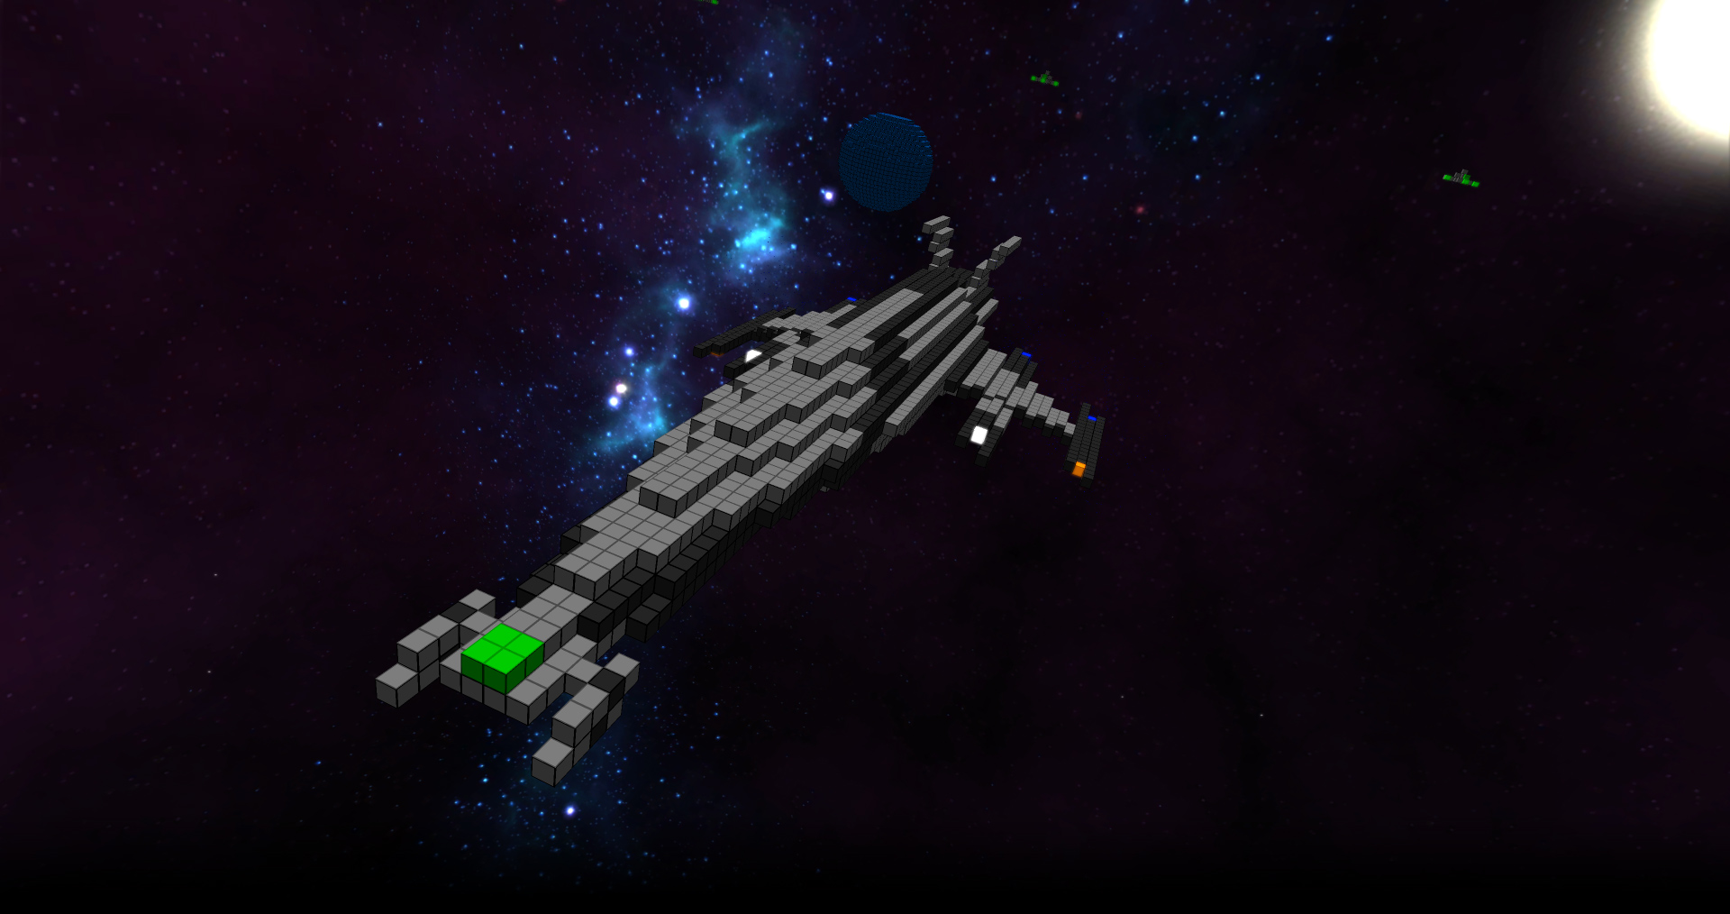

Slide 30
zoxel hat ssao, warum wir nicht? - kleine strukturen
unterschied voxel/partikel
wieviele voxel in einer scene?
worldtree beschreiben
partikel über quads rendern
farbschema
modbarkeit

